Slide 1
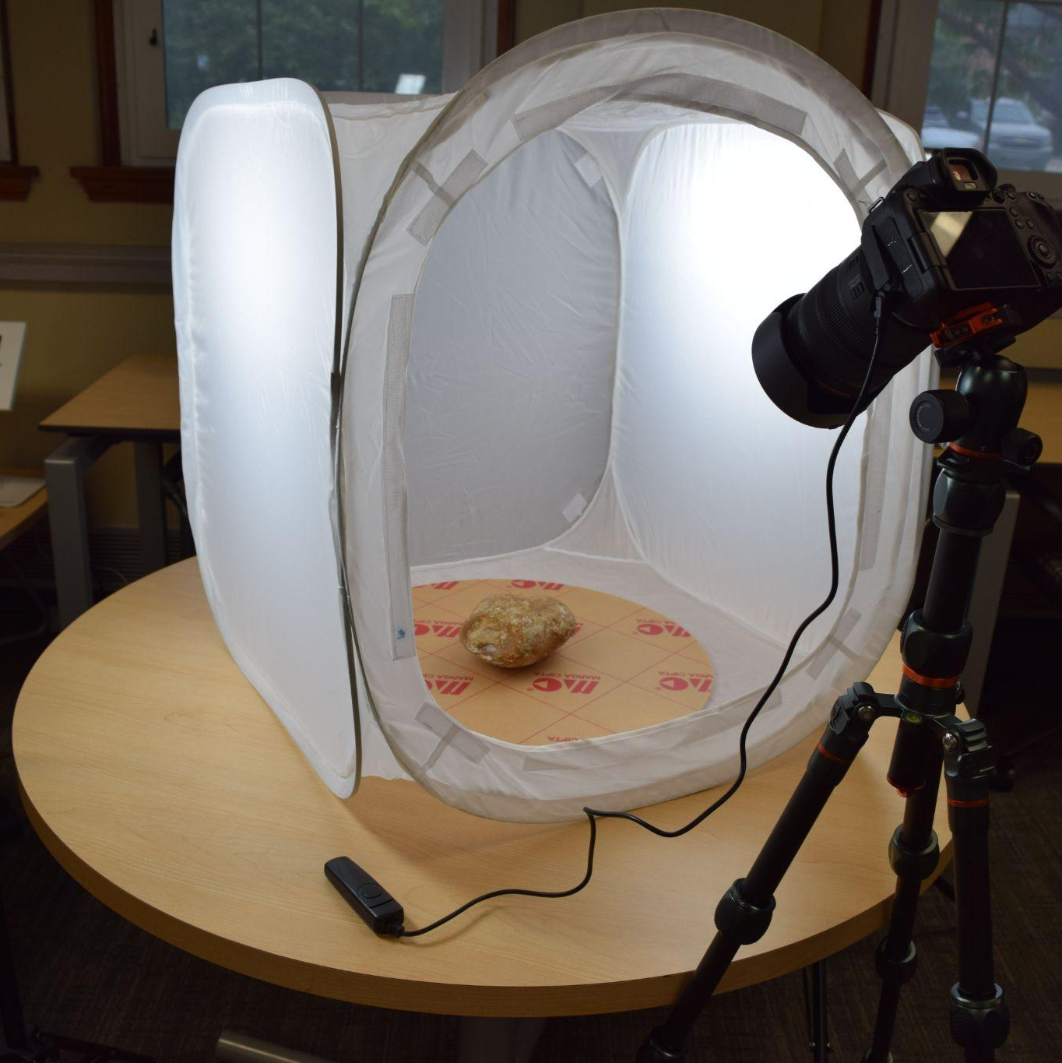
Digitization, Copyright, + Licensing
Cultural Heritage Informatics 2025-2026

Slide 2
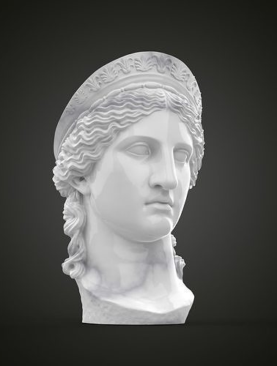
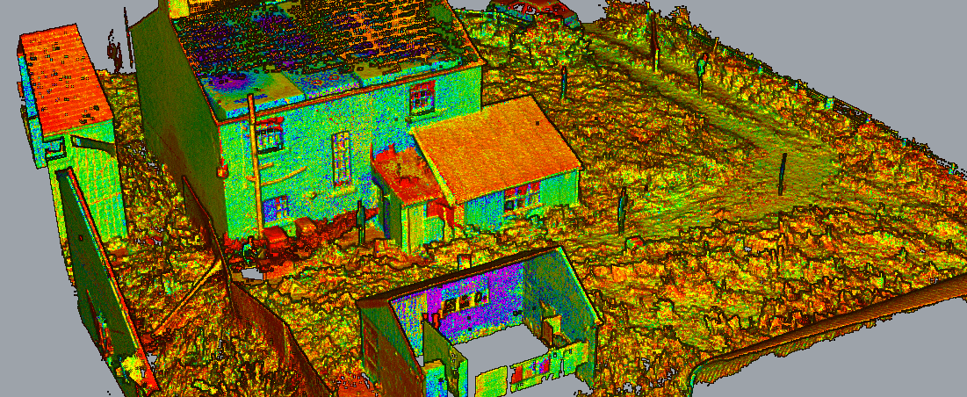
Digitization
Notes:
Digitization is no longer a new phenomenon, and digital photographs of paintings and scanned books are increasingly being used for the preservation and dissemination of cultural heritage. This is one process of converting analogue data into digital data, but there are things to be aware of. Dealing with a retro digitised source on a screen is very different to sitting in an archive and holding an original letter in your hand.
Developments in technology have also made it easier to make digital twins or copies of cultural heritage, which can be beneficial for bringing separated artefacts together or revive heritage that was permanently lost, this ranges from individual objects held in museum collections to complete immovable sites. The ability to rotate a digital model 360°, examine it from all angles, and zoom in to study intricate details vastly expands the tools in a scientist’s arsenal. Even the ability to remove features can be useful – for example, taking away color and viewing an object in crisp black and white can reveal markings that would not otherwise be noticeable.
Digitization aids preservation by creating digital copies of physical materials, making them more accessible and durable. Digitization is NOT preservation – it is the first step to preservation and access. You are not preserving the tangible thing - preserving the digital object. If you are doing preservation, you need to do conservation.
The first phase of digitization began around 30 years ago and was closely related to computational humanities. Its first phase focused on how new mainframe computers could be used to collect and manage data – for example the collection of economic data (sales statistics), environmental data (weather records), and demographic data (marriage and birth rates) over long periods of time. The second phase, starting in the 1990s, was defined by the mass digitisation of analogue sources by cultural heritage institutions such as archives, libraries and museums. We are now in the third phase which is focused on the critical reflection of how new digital research infrastructures and tools change, how we think about cultural heritage and what narratives we produce. In short, how does the digital affect our imagination of the past and thus our conception of heritage?
How you digitize materials depends on:
1. What you are digitizing?
2. What are your motivations?
Digitation for documentation
Digitation for Federation
Digitization for Access
3. What limitations might be involved with the materials you are digitizing?
Condition of materials
Access to materials
Issues of security and safety
4. What is your capacity (infrastructure and capability)?

Slide 3
Challenges + Ethics
Scaling Up or Feasibility
Funding
Environmental Impact
Sustainability + Technological obsolescence
Intellectual Property Rights Management
Cultural Disenfranchisement
Notes:
Digitization is taking pace for a variety of reasons including violent conflict and climate change. A study conducted in 2022 found that, of 244 UNESCO cultural and heritage sites surveyed across the Mediterranean region, the majority are already vulnerable to the threats of man-made climate change and extreme events—and using the Intergovernmental Panel on Climate Change’s worst-case scenario for future CO2 emissions, 35 of these sites would fall under the ‘high hazard’ category, while another 12 would fall under the “extreme hazard” category. Both tangible and intangible heritage artifacts—from physical relics to oral histories—are now being captured and preserved via diverse digital tools and techniques. In addition to supporting the resilience of cultural and historical heritage, digitization can help make heritage sites and artifacts more accessible to a wider audience, ultimately enhancing the interest, activism, and political will necessary to gain greater investments in heritage preservation. They also serve as provenance records in case of theft, significantly increasing the odds of repatriation if the object is recovered.
Not all digitization efforts and methodologies are created equal. Digital preservation has burst into public consciousness because it has the ability to recreate destroyed sites of heritage and endless other possibilities. One of the biggest challenges in this field is scaling up or feasibility. Just as with physical preservation efforts, not all heritage assets can be digitized, and practitioners and community members must still make decisions about what assets to prioritize. Furthermore, when considering the sustainability of digital records, it’s important to remember that digitization does leave a carbon footprint. Heritage institutions that digitize their collections are confronted with a widely debated aspect of collection management, namely the selection of content. As not every item can be safeguarded for financial and organizational reasons.
Before we even get to digitization, workflows have to be altered and refined and the obsolescence of formats, hardware or software, must be offset with investments for restoration and storage systems. This is an expensive process. Heritage institutions have to bear in mind that digitization will not be the solution since it is assumed that digital carriers are fragile media for two reasons: 1) they have a restricted life span or short ‘shelf life’ and 2) certain types of computer hardware and software are rapidly becoming obsolete. Going digital requires a continuous focus on new methods, infrastructure, and practices for digital content safeguarding.
The digital revolution has fostered new epistemic values and virtues such as openness, transparency, traceability and sharing, which now sit alongside the traditional epistemic values of objectivity and accuracy. However, divisions and inequities in the infrastructures that determine access to knowledge are being reproduced in the digital realm, with even greater impact. For example, issues such as the overrepresentation of English and European languages in mass digitisation of cultural heritage collections mean that the rich cultural heritage of countries such as China or Japan or of the many oral knowledge treasures of indigenous cultures around the world is not feeding into the new digital knowledge base that we are building.

Slide 4
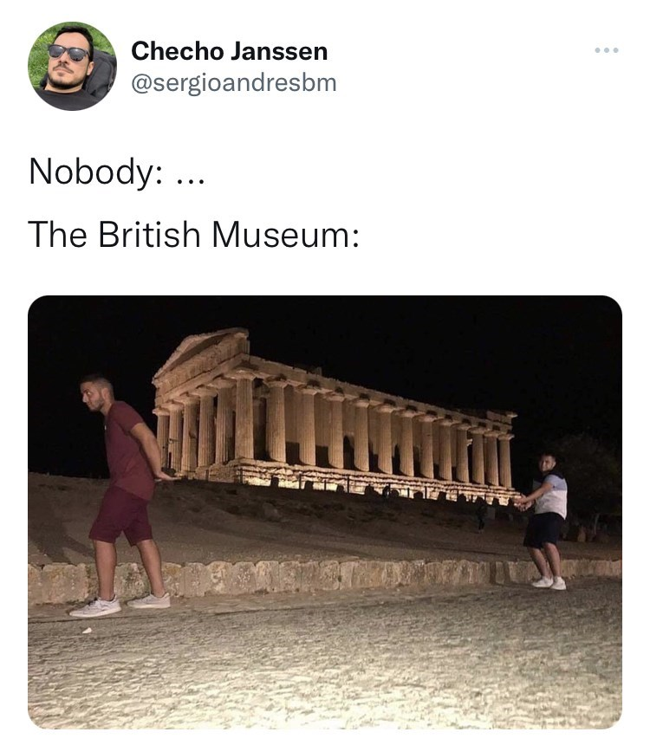
Best Practices
Community Buy-In
Sustainability
Ethics + Accurate Representation
Accessibility
Selection Strategies
Notes:
Community Buy-In: These efforts are for naught without the engagement and buy-in of local communities. We have learned that we must approach digitization with humility, and with the express commitment that community members make the ultimate determination about what is worth digitizing and how it is presented. Don’t be the British… don’t just be stealing shit. Training and empowering community members to participate in the process will provide rich cultural nuance and better metadata. This provides successful frameworks for responsible, sustainable digital heritage preservation and demonstrating the key tenet of these efforts: that they should ultimately work in service of local partners and communities.
Sustainability: At its core, sustainability represents the practice of preserving digital heritage → our digitally created or digitized cultural and historical assets → in a way that is environmentally, economically, and socially responsible for the long term. This definition extends beyond mere digitization; it encompasses a holistic approach to ensure that future generations can access and appreciate our digital past without compromising the planet’s resources or societal well-being. Digital data is fragile, technology becomes obsolete, and energy consumption associated with digital storage and access has a considerable environmental footprint. Being sustainable involves being economically, environmentally, and socially sustainable. This includes optimizing storage, using energy efficient tech, managing the lifecycle of a project, collaborating and making sure there is awareness of the project and its fundamentals.
Ethics + Accurate Representation: The rapid spread of the internet and mobile technologies has facilitated cross-cultural interactions, leading to the blending of cultural values and practices on a global scale. This is where we need to be careful because while it fosters cultural enrichment and connectivity, it also poses risks to cultural diversity and equity. The material should be ethically sourced with permissions and have accurate descriptions and representations of culture and identity present in the metadata.
Access: When we say “access,” we me access to the digitized materials and associated metadata by the public (whether that be me you, the greater academic community and beyond). When we say “access” we mean a publicly accessible website or page that allows people to interact with the data. Evidence suggests that the more people are exposed to other cultures through digital technologies, the more open they become to other cultures and other social groups. Accessibility matters on a socio-cultural level as well as a socio-economic level.
Selection Strategies: UNESCO advocates for individual libraries, archives, and museums to select, identify, and prioritize digital heritage before it is lost. Existing institutional missions, mandates, and collection development policies for physical collections, in most cases, will provide the starting point and essential guidance for assessing and selecting digital heritage. An institution should answer these questions by evaluating the relative significance of the digital heritage to its mandate and public; by assessing its sustainability, that is, its capacity to preserve it for long - term access and use; and by considering its availability in other heritage institutions, that is, its prospects for preservation elsewhere, and what is the most appropriate institution to preserve it.

Slide 5
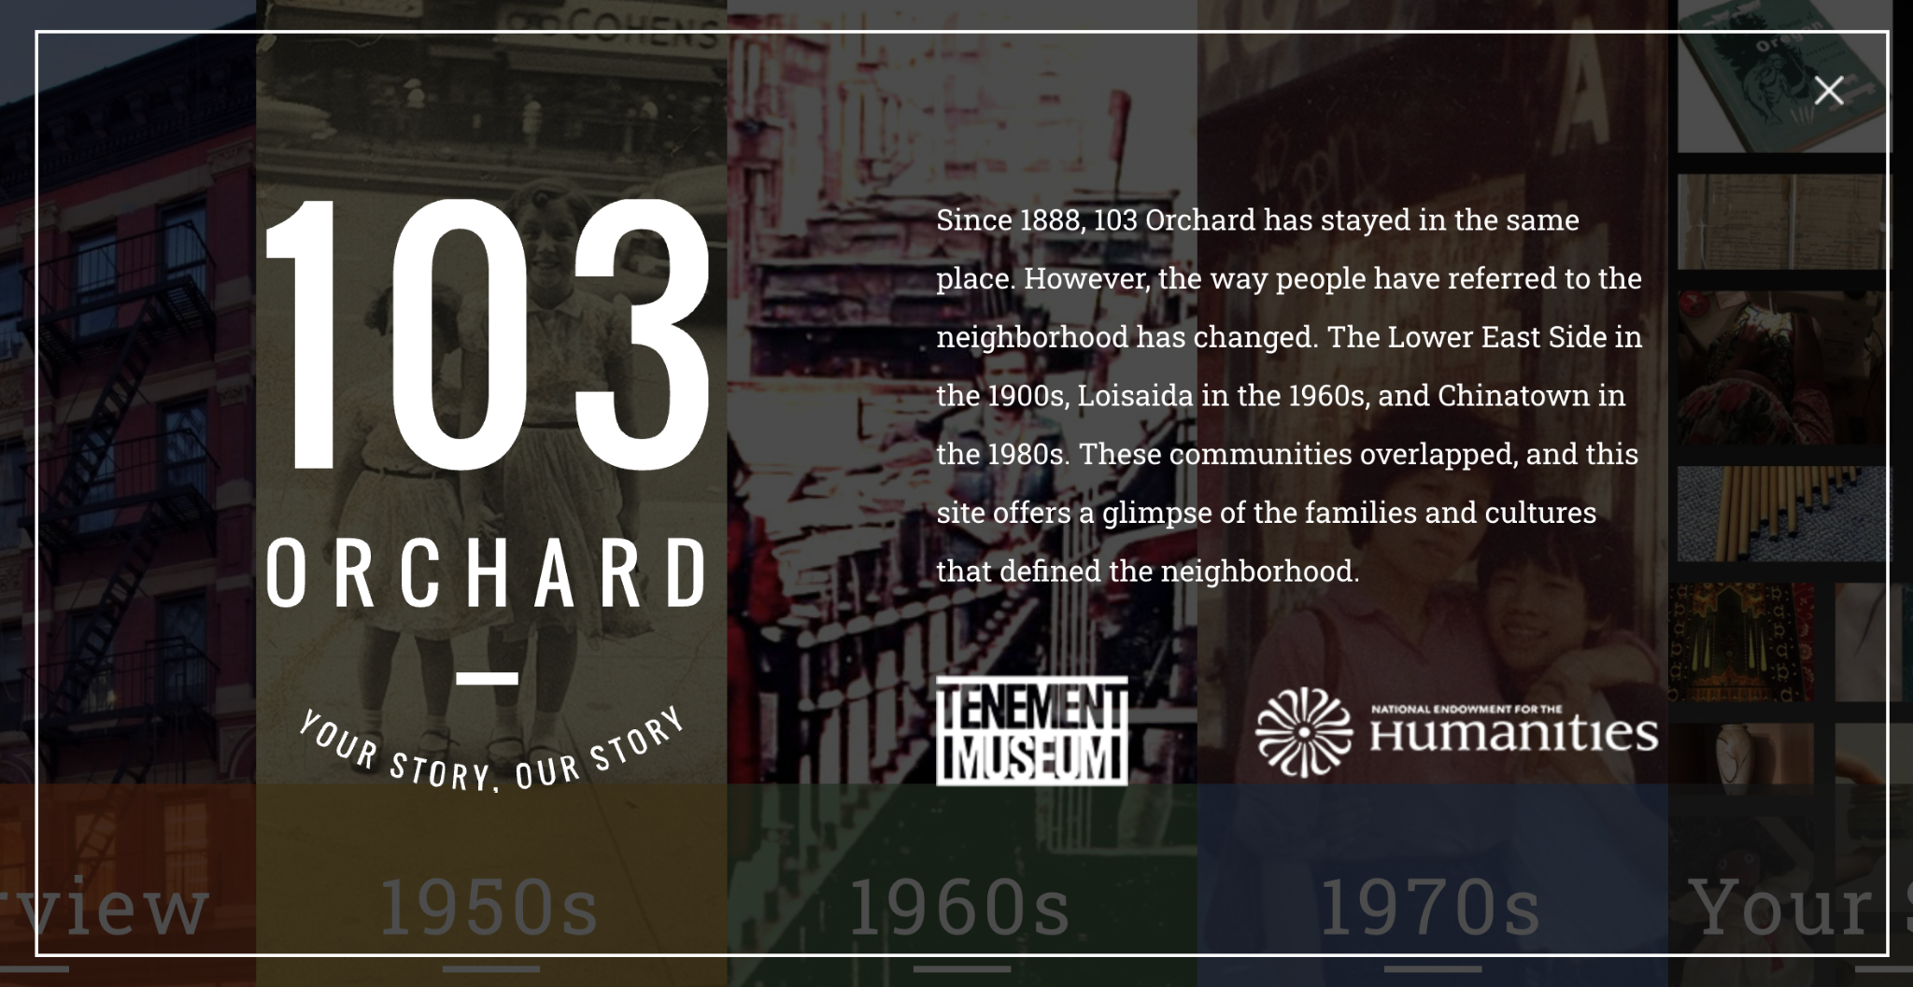
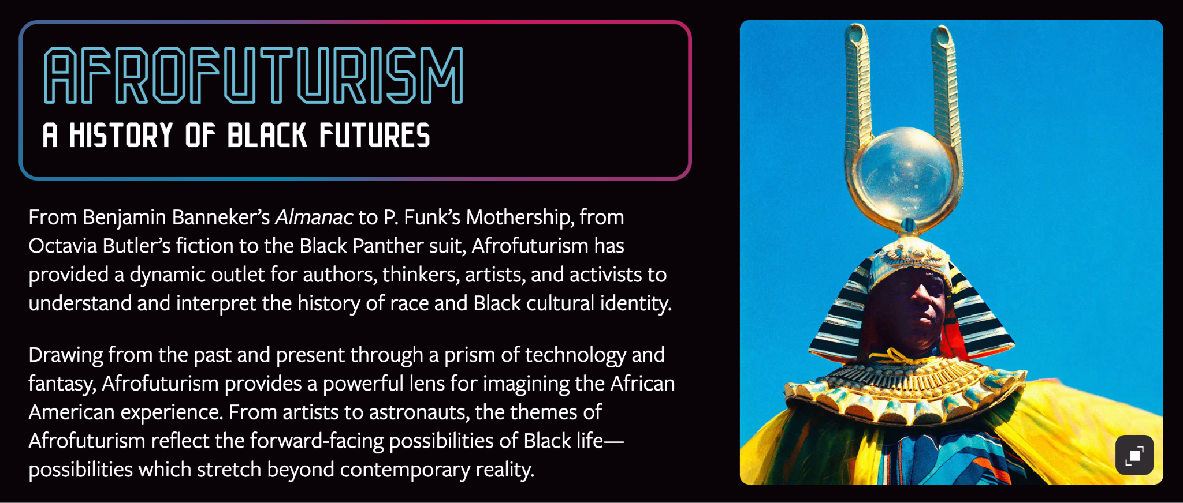
The Digital Media Era
Notes:
With the advent of the information society and the digital age, the dissemination of cultural heritage is gradually moving away from the traditional face-to-face embodied presence toward digital communication that transcends the limits of space and time. Our visual experience has also shifted from the traditional creation and reception of visual images to the invention and immersion in new worlds of spectacle.
The modernization of visual media technology has led to the modernization of visual concepts. With the advent of the information society and the digital age, our visual experience has changed from the traditional acceptance of visual images to immersion in a new spectacle world. “VR” is a new visual derivative of traditional media. On the one hand, it includes the genes of traditional visual media, and on the other hand, it contains the materialization of new visual media and the characteristics of visual media that change from old to new. With the help of digital information technology, people's visual imagination and space exploration scope have been greatly expanded.

Slide 6
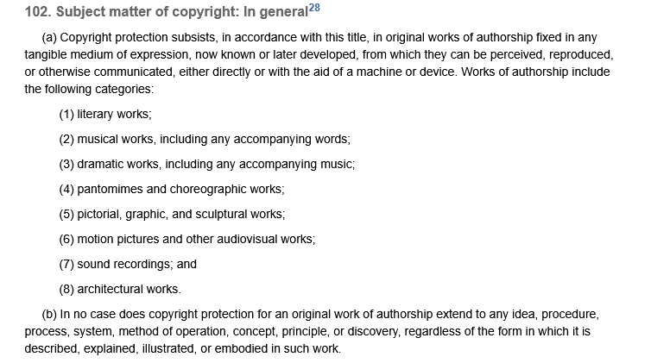
Copyright and Licensing
https://www.copyright.gov/title17/92chap1.html#102
Notes:
Two different things, both relevant for digital cultural heritage work especially since there is so much digitization and archive work going on by CHI fellows
Copyright is who owns it
Section 102 of us copyright law dictates what subject matter is eligible to copyright. Note that this works of tangible expression, but NOT the idea itself
Section 106 details the rights are to controlling work
Licensing is how it can be used
If licensing allows you to use a thing and you create metadata - you own the metadata (which also means you need to decide how to share that)

Slide 7
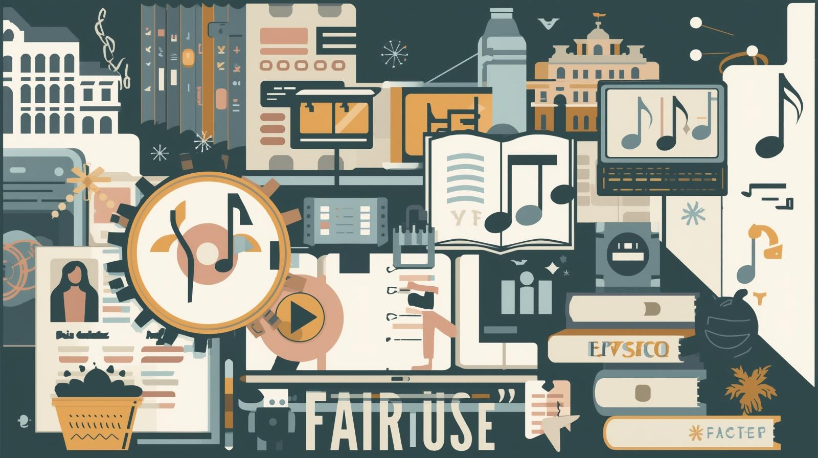
Fair Use
Section 107: Fair Use
Nature of the use of copyrighted work
Nature of the copyrighted work
Proportion of the work being used
Effect of use on the commercial value
Section 108: Reproduction by Libraries and Archives
Notes:
The principle of fair use allows certain uses of copyrighted material without requiring the user to get the permission of the copyright holder. Quoting or reproducing small amounts of an author’s or artist’s work in order to review or criticize it or to illustrate the user’s own argument are examples of fair use.
Factors in Determining Fair Use (in the US)
-Nature of the use of copyrighted material
-Nature of the copyrighted work
-The proportion of the copyrighted work being used
-The effect of the use on the commercial value of the work being quoted or reproduced
Use is probably fair if:
-Unlicensed use transforms the copyrighted material
-The reproduced part of the work is used in an education setting with no monetary gain
-Material is used in a appropriate way (meaning is not distorted, source is cited, its important to the users argument
-Only a small portion of the copyrighted work is reproduced
-Use is reasonable according to the standards of the field
-Section 108 of the Copyright law also outlines specific provisions for libraries and archives for replicating/using materials
- However this was written in the 1970s and its very complex based on the type of institution and use, and isnt really applicable directly to digital works further complicating matters

Slide 8


Public Domain
Cornell Library: Copyright Term and Public Domain
Notes:
Public domain are works that are not protected by copyright law (e.g., expired copyright, its not copyrightable, or is put into the public domain by its creator)
Not unpublished works heading into public domain are often more complicated that unpublished works (e.g., death starts the clock so something created more than 70 years ago, but the indiv died 30 years ago)
Also sound copyright is incredibly complicated (https://www.recordingcopyright.org/pdf/AMuscop_fnl.pdf)
-https://msupress.org/author-information/current-authors/permissions/
-https://aupresses.org/permissions-faq/

Slide 9
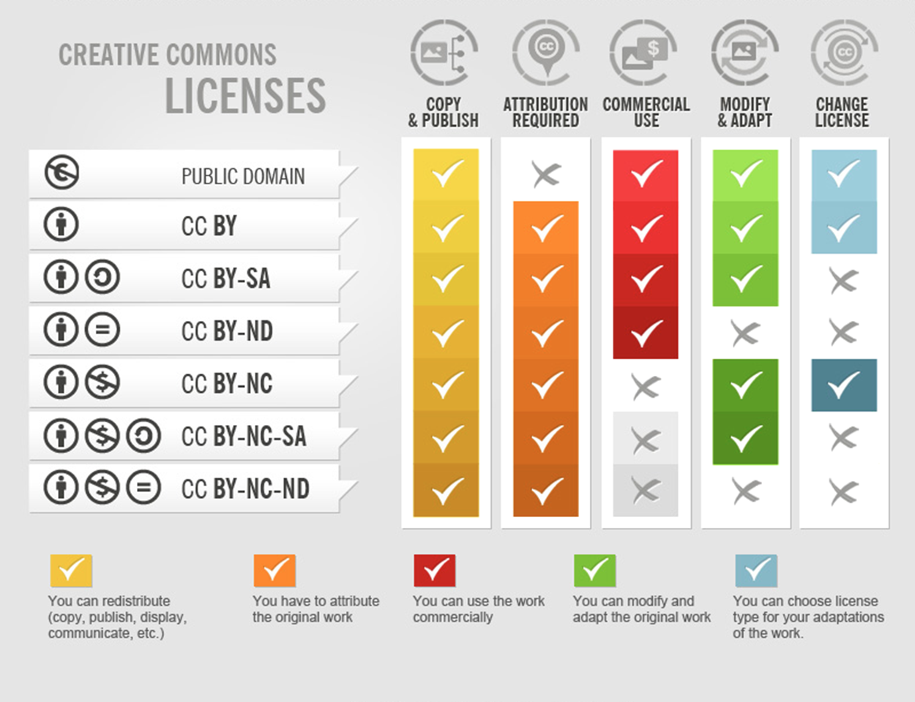
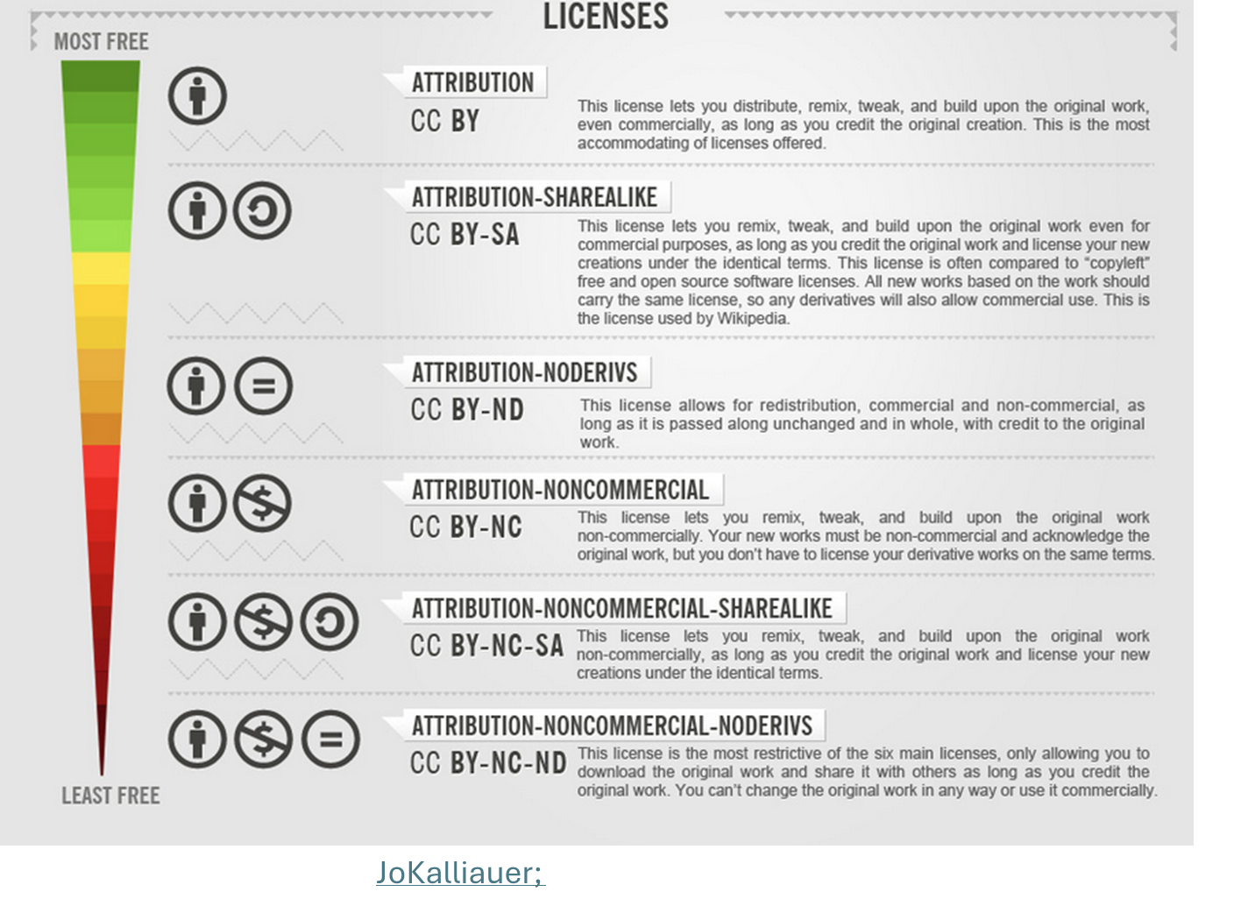
Creative Commons
Notes:
Probably the easiest material to figure out useability are things under creative commons
Generally need to provide attribution

Slide 10
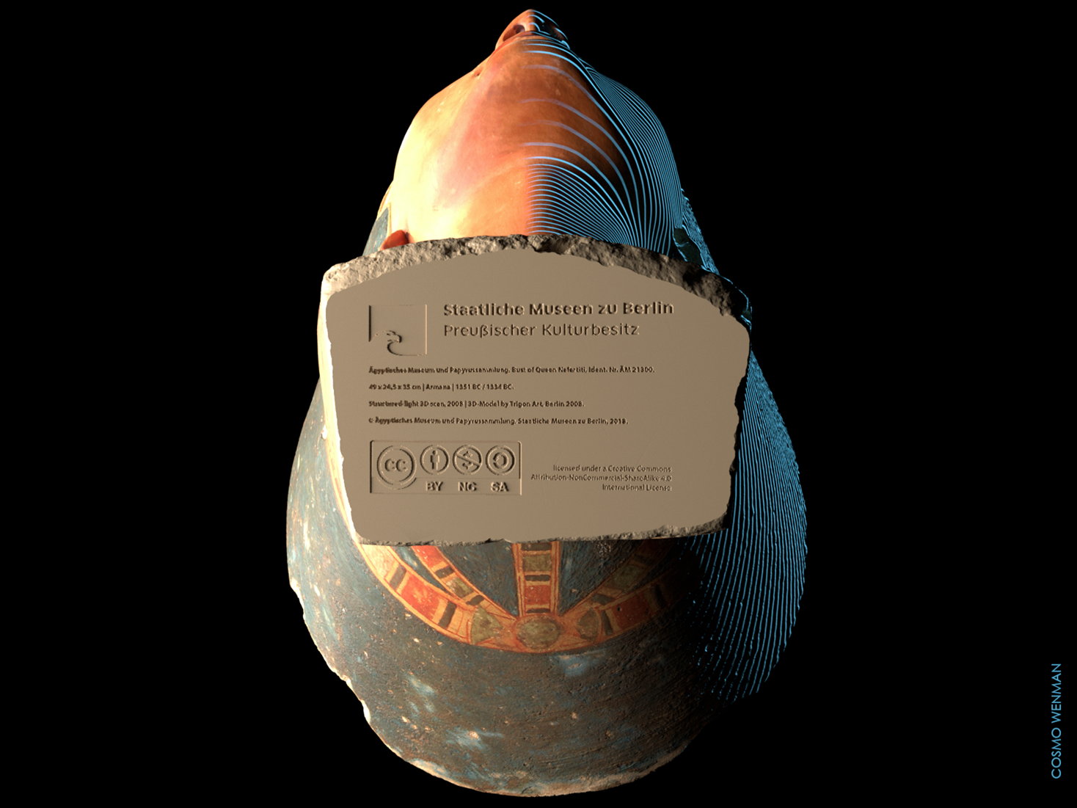
Nefertiti Problem
Notes:
When the museum released the scan of the bust (under a German freedom of info request), they attached a Creative Commons license on the bottom even though its clearly in the public domain and (at least in the US) scans of objects under public domain are public domain
https://www.techdirt.com/2019/11/22/curious-case-bogus-cc-license-3d-scan-3000-year-old-bust-nefertiti/
https://michaelweinberg.org/post/140380940730/the-bust-of-nefertiti-who-owns-the-copyright-to
https://www.museumnext.com/article/legal-case-concerning-a-3d-scan-of-a-museum-artefact-may-impact-on-all-institutions/
https://sarahemilybond.com/2021/05/25/nefertiti-and-digital-colonialism-a-short-bibliography/

Slide 11
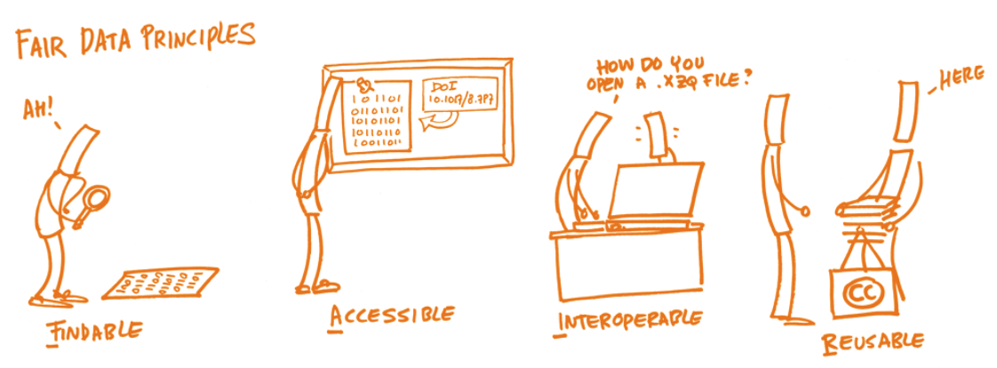
FAIR Principles
https://www.go-fair.org/fair-principles/

Slide 12
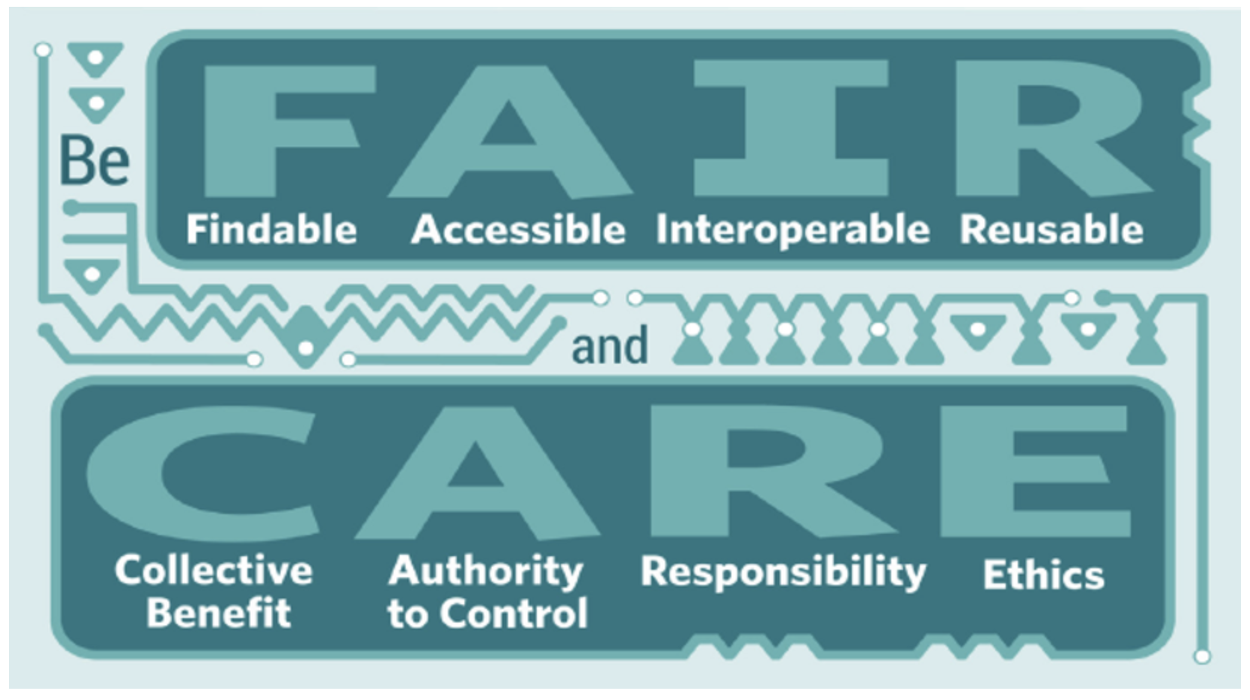
https://www.gida-global.org/care

Slide 13
Copyright and Licensing: Take Homes
Know the laws (or know who to ask)
Decide the copyright applicable to your work and display it
Understand how these laws can work to your advantage
Useful Resources:
MSU Copyright Office
MSU Press - Copyright Basics
Creative Commons
Notes:
Digital works and copyrights is complicated and has moved beyond the law so there is flexibility if you understand your rights and restrictions.

